Slide 1
Operating System Fundamentals
Computer Engineering
Notes:
Introduction to the presentation on Operating System Fundamentals.

Slide 2
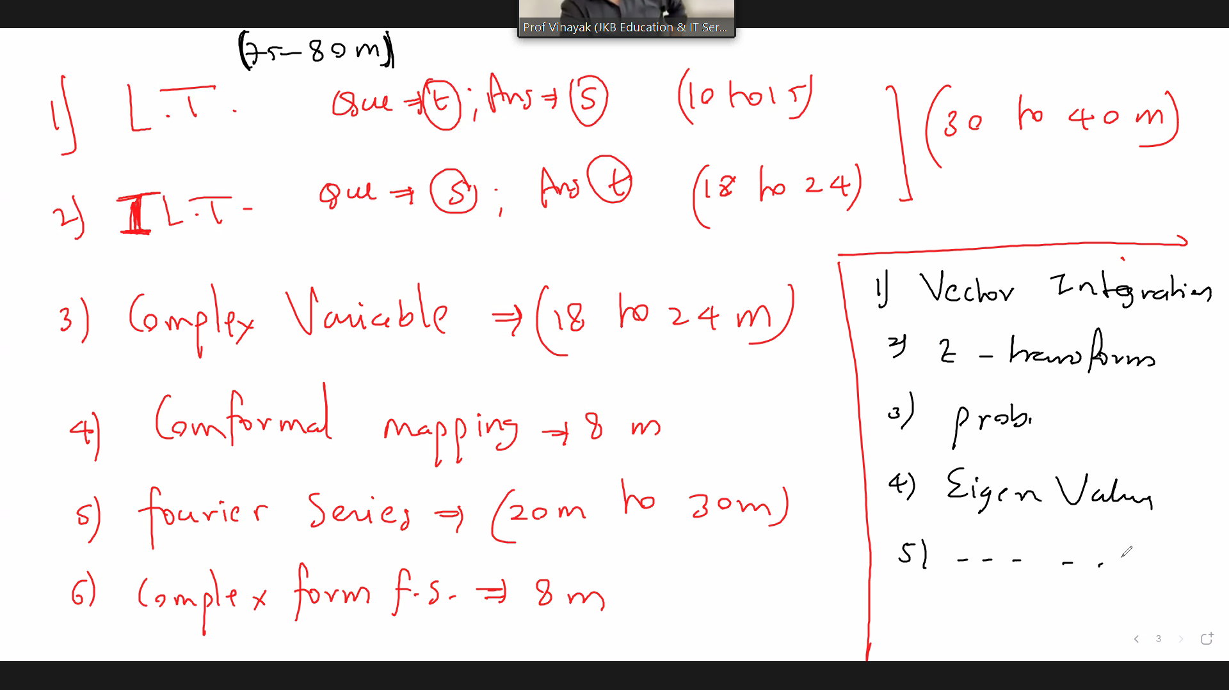
Introduction to Operating Systems
Operating systems manage computer hardware and software resources efficiently and effectively always
OS provides a platform for running applications and services seamlessly and securely always
Primary function of OS is to manage memory and storage devices efficiently always
Operating systems provide a user interface for interacting with computer systems easily
OS manages input output devices such as keyboards and displays effectively always
Security and authentication are critical components of modern operating systems always
Operating systems support multitasking and multithreading capabilities always
Device management and file systems are essential operating system components always
Error handling and debugging are important features of operating systems always
Notes:
Explain Introduction to Operating Systems in the context of Operating System Fundamentals.

Slide 3
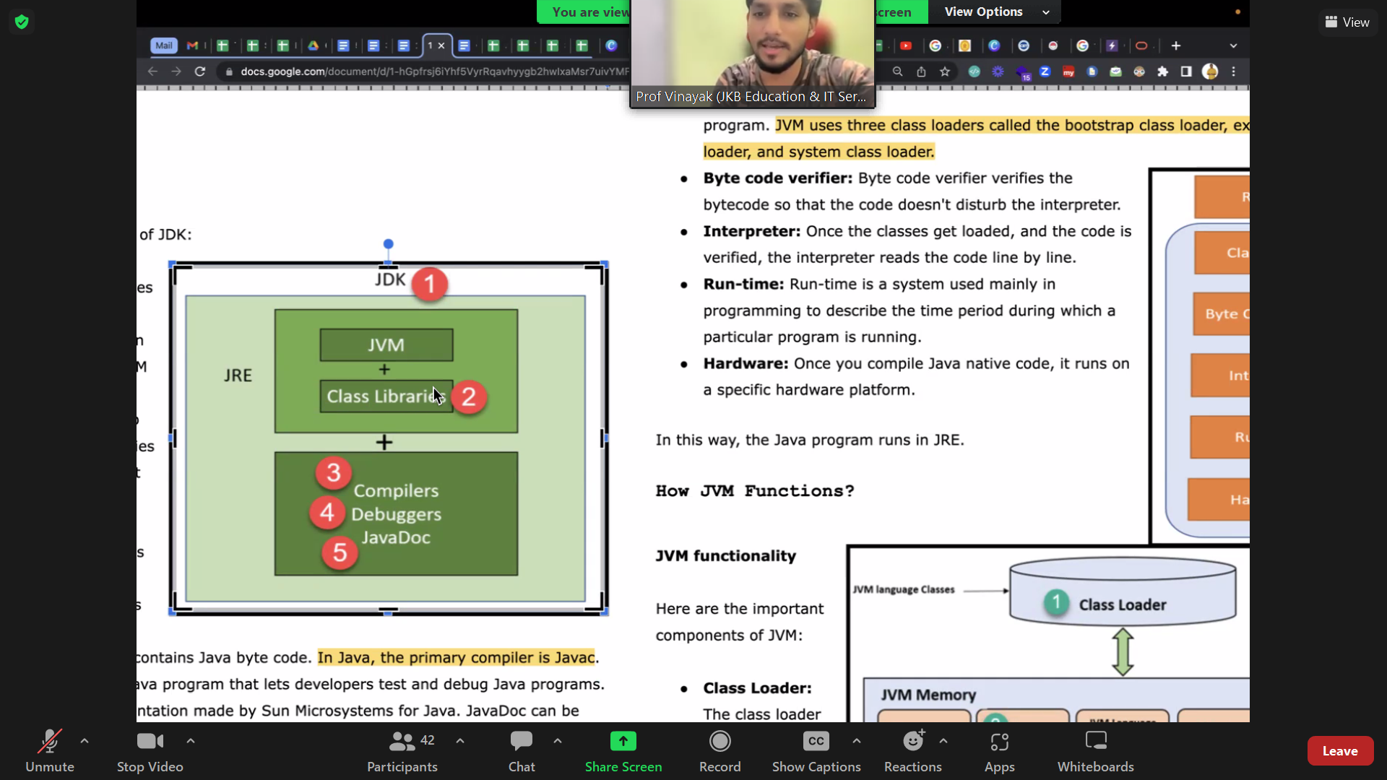
Process Management Architecture
Process management involves creating, scheduling, and terminating processes efficiently
Operating systems use process control blocks to store process information
Process scheduling algorithms determine the order of process execution
Context switching enables the operating system to switch between processes
Process synchronization mechanisms prevent data inconsistencies and deadlocks
Interprocess communication allows processes to exchange data and coordinate actions
Process states include ready, running, waiting, and zombie states
The process manager handles process creation, deletion, and synchronization
Process priority scheduling allocates CPU time based on process priority
Notes:
Explain Process Management Architecture in the context of Operating System Fundamentals.

Slide 4
Memory Management Techniques
Memory allocation techniques manage memory efficiently for optimal system performance and productivity
Paging enables efficient memory allocation and deallocation with minimal overhead and fragmentation
Segmentation divides memory into logical segments for easier management and access control mechanisms
Virtual memory combines physical and secondary storage for increased memory capacity and flexibility
Swapping involves exchanging pages or segments between main memory and secondary storage devices
Cache memory stores frequently accessed data for rapid retrieval and improved system responsiveness
Memory protection mechanisms prevent unauthorized access and ensure data integrity and security
Dynamic memory allocation allows programs to request and release memory as needed during execution
Memory fragmentation occurs when free memory is broken into small, unusable blocks and requires defragmentation
Notes:
Explain Memory Management Techniques in the context of Operating System Fundamentals.

